Slide 1
BTW #3

Slide 2
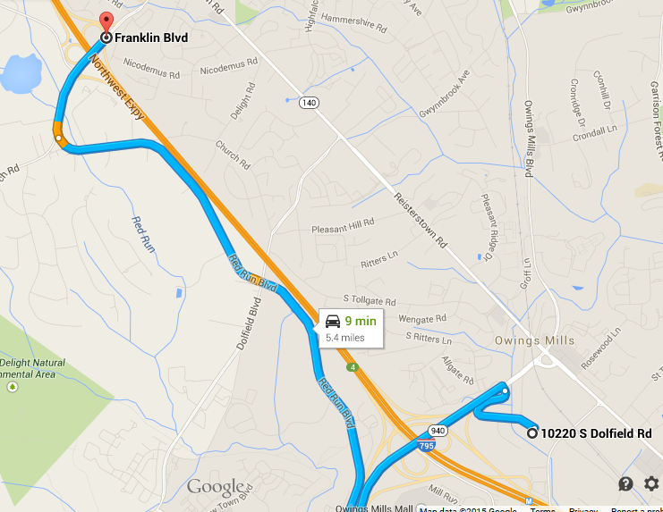

Slide 3
